Slide 1
Georgia Health and Social Projects’ Implementation Centre 1 February 2011
GHSPIC Investment Projects

Slide 2
PROJECTS MANAGED AND IMPLEMENTED BY GHSPIC
STATE PROGRAMS
Program for the rehabilitation and equipment of medical institutions as well as institutions under the ministry structure
WORLD BANK FUNDED PROJECTS
Health Sector Development Project
Avian Influenza Control and Human Pandemic Preparedness and Response Project
GLOBAL FUND SUPPORTED PROJECTS
Strengthening the National Response to HIV/AIDS
Enhancement of HIV/AIDS Prevention, Treatment, Care and Support Interventions in Georgia
Consolidation the Results Achieved: Containing Further an Epidemic of Malaria
Bridging the gap in the management of drug-resistant tuberculosis in Georgia
EU SUPPORTED PROJECTS
Primary Health Care Reform Support Project

Slide 3
GHSPIC Investment Projects
Infrastructure:
a) Hospital Sector
b) Primary health care sector
c)Public health/Lab network
Human Resources

Slide 4
Hospital Sector Development master plan – creation of modern Hospital network within the country on 7800 beds (government decree №11, 2007 January 26)
Ongoing Reconstruction and rehabilitation of 102 Hospital.
State Budget - 20
Private Investment - 76
Donor Aid - 6

Slide 5
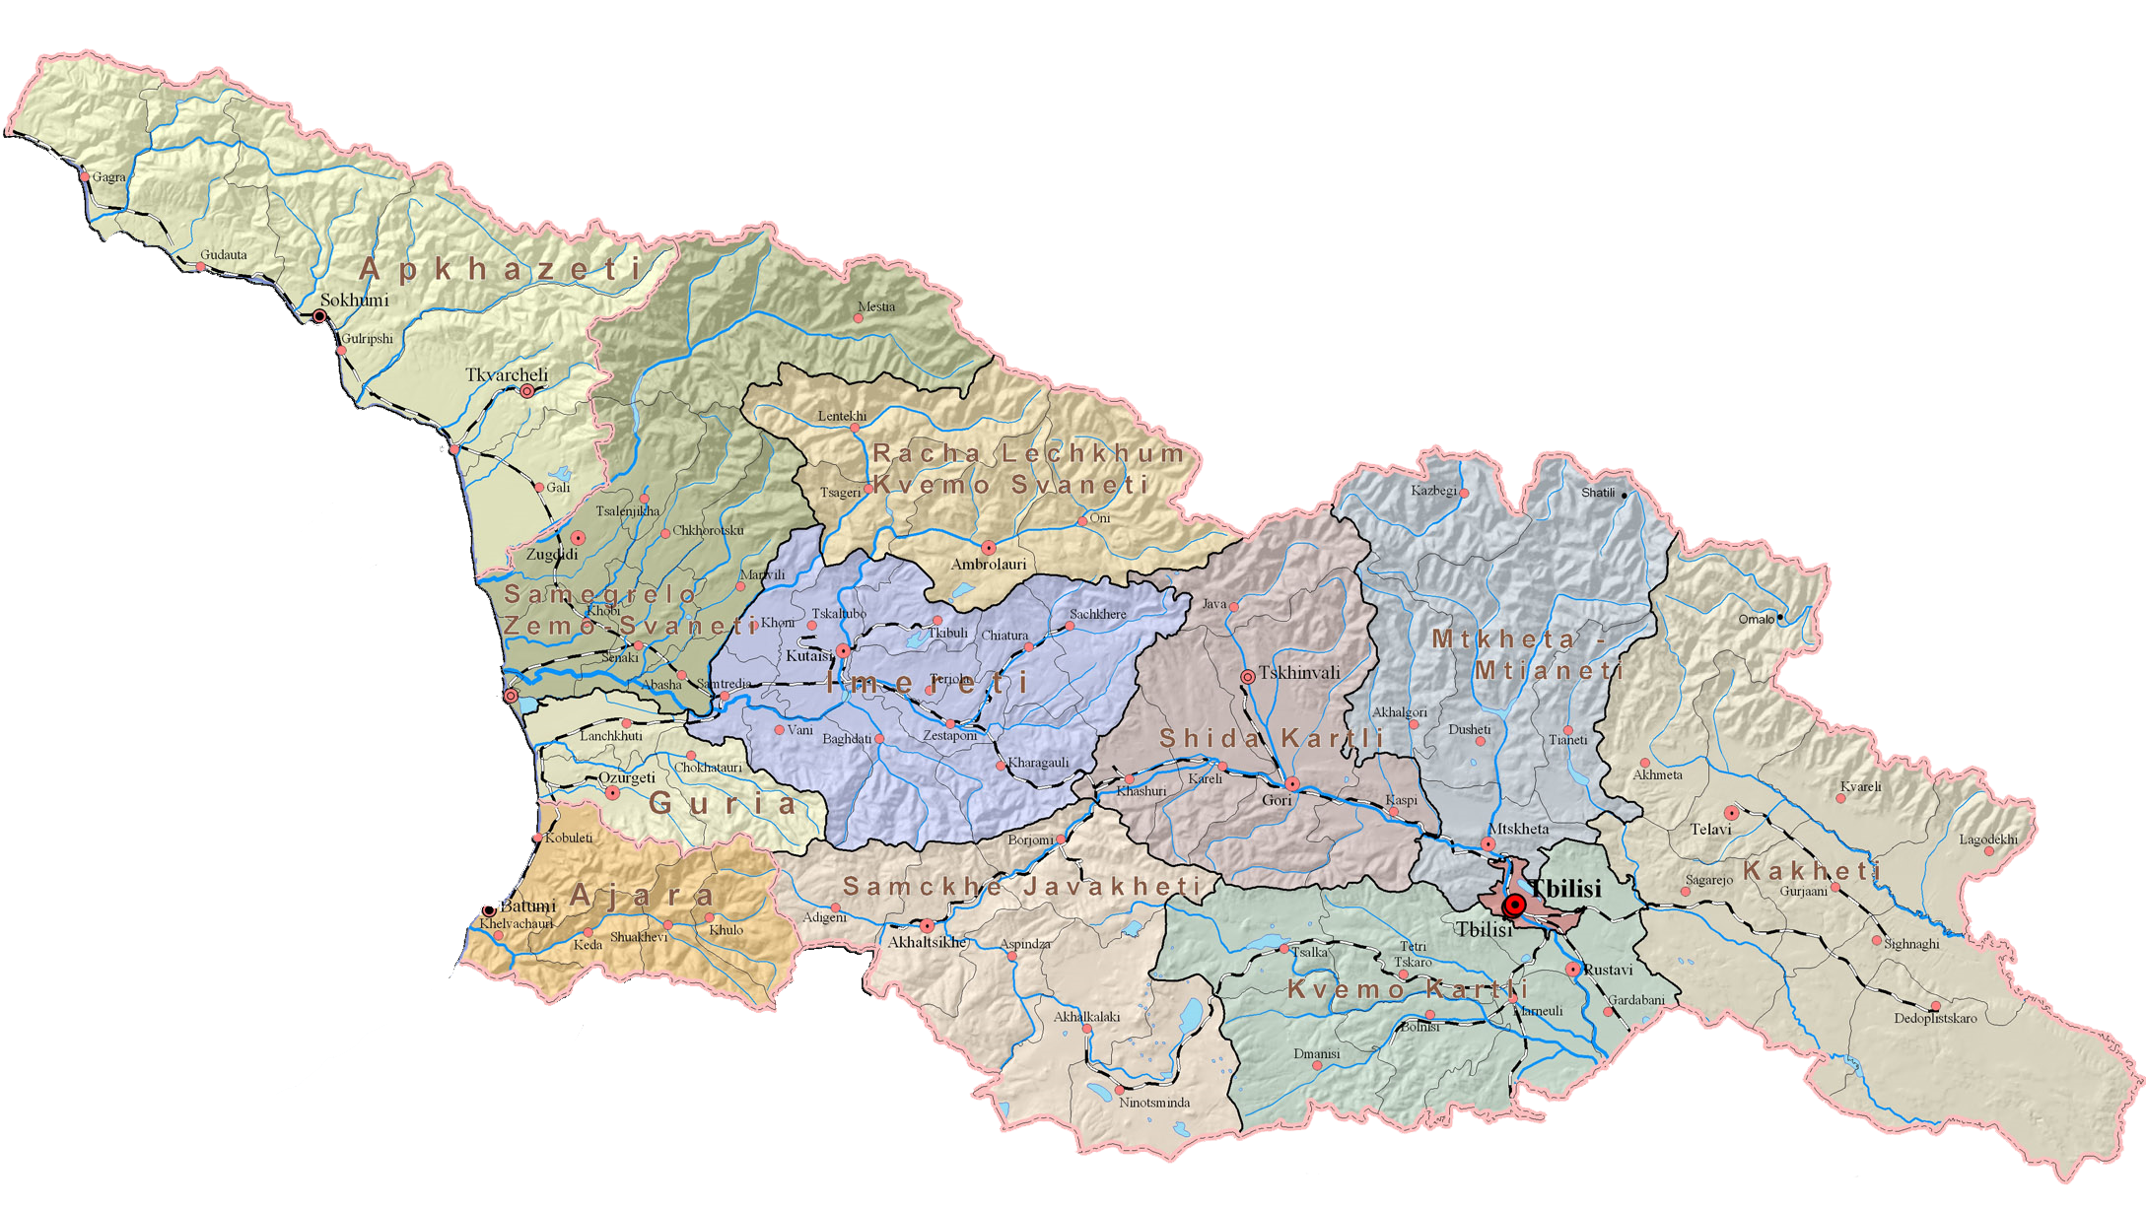
Service Provision: Hospital Sector
President’s Initiative on 102 New Hospitals
102 hospitals should be rehabilitated countrywide
7 800 hospital beds should
be rehabilitated countrywide
Tbilisi 35
Regions 67
Notes:
Privatization process that has been announced in 2007. To entice investors: property in the center of the city in exchange of new, modern and modernly operated hospitals. The simpliciy of the plan was attractive and theoretically it resolved several headaches with one deal. Georgia would receive modern hospitals, in buildings that were designed and constructed to be hospital, and they would be managed by international companies experienced at treating healthcare as an industry, not a state subsidy. Especially those buildings that are in downtown.
The privatization process slowed down dramatically, because of the financial crisis (Sandro thinks that this is positive as only investors that are still interested are those who want to invest in healthcare, not those who are looking to turn a fast profit in real estate development).

Slide 6
State budget- 20
Private Investments - 76
Donor Aid – 6
Total 102 Hospital
Abxazia
Tbilisi
35
svaneti
3
Raja-Lechxumi
2
samegrelo
8
Mcxeta-Mtianeti
5
imereti
14
guria
3
Shida qartli
4
Kaxeti
8
adjara
7
Samcxe-Javaxeti
7
Qvemo Qartli
6

Slide 7
State Obligations
Rehabilitation and Reconstruction of 20 Medical facilities. Most of them will be finished in April 2011.
Consolidation Project in Tbilisi
on the territory of G.Jvania Pediatric Clinic and Tbilisi Central Hospital
Psychiatry Hospital
Tuberculosis and Lung disease national centre
Infectious pathology ,aids and clinical immunology research centre

Slide 8
Donor Organizations
World Bank
Ambrolauri Regional Hospital
Gori primary care centre
Global Fund
Tuberculosis Centre
HIV Aids Centre
USAID
Akhaltsikhe Hospital
Akhalkalaki Hospital
Ninotsminda Hospital

Slide 9
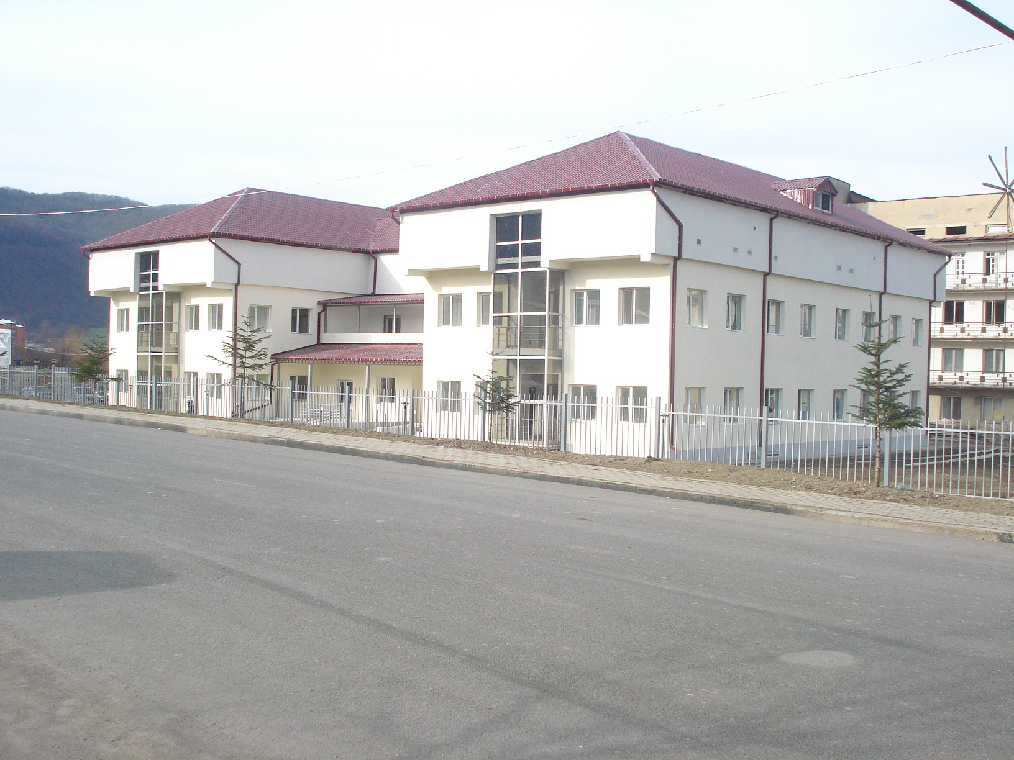
Ambrolauri Regional Hospital

Slide 10
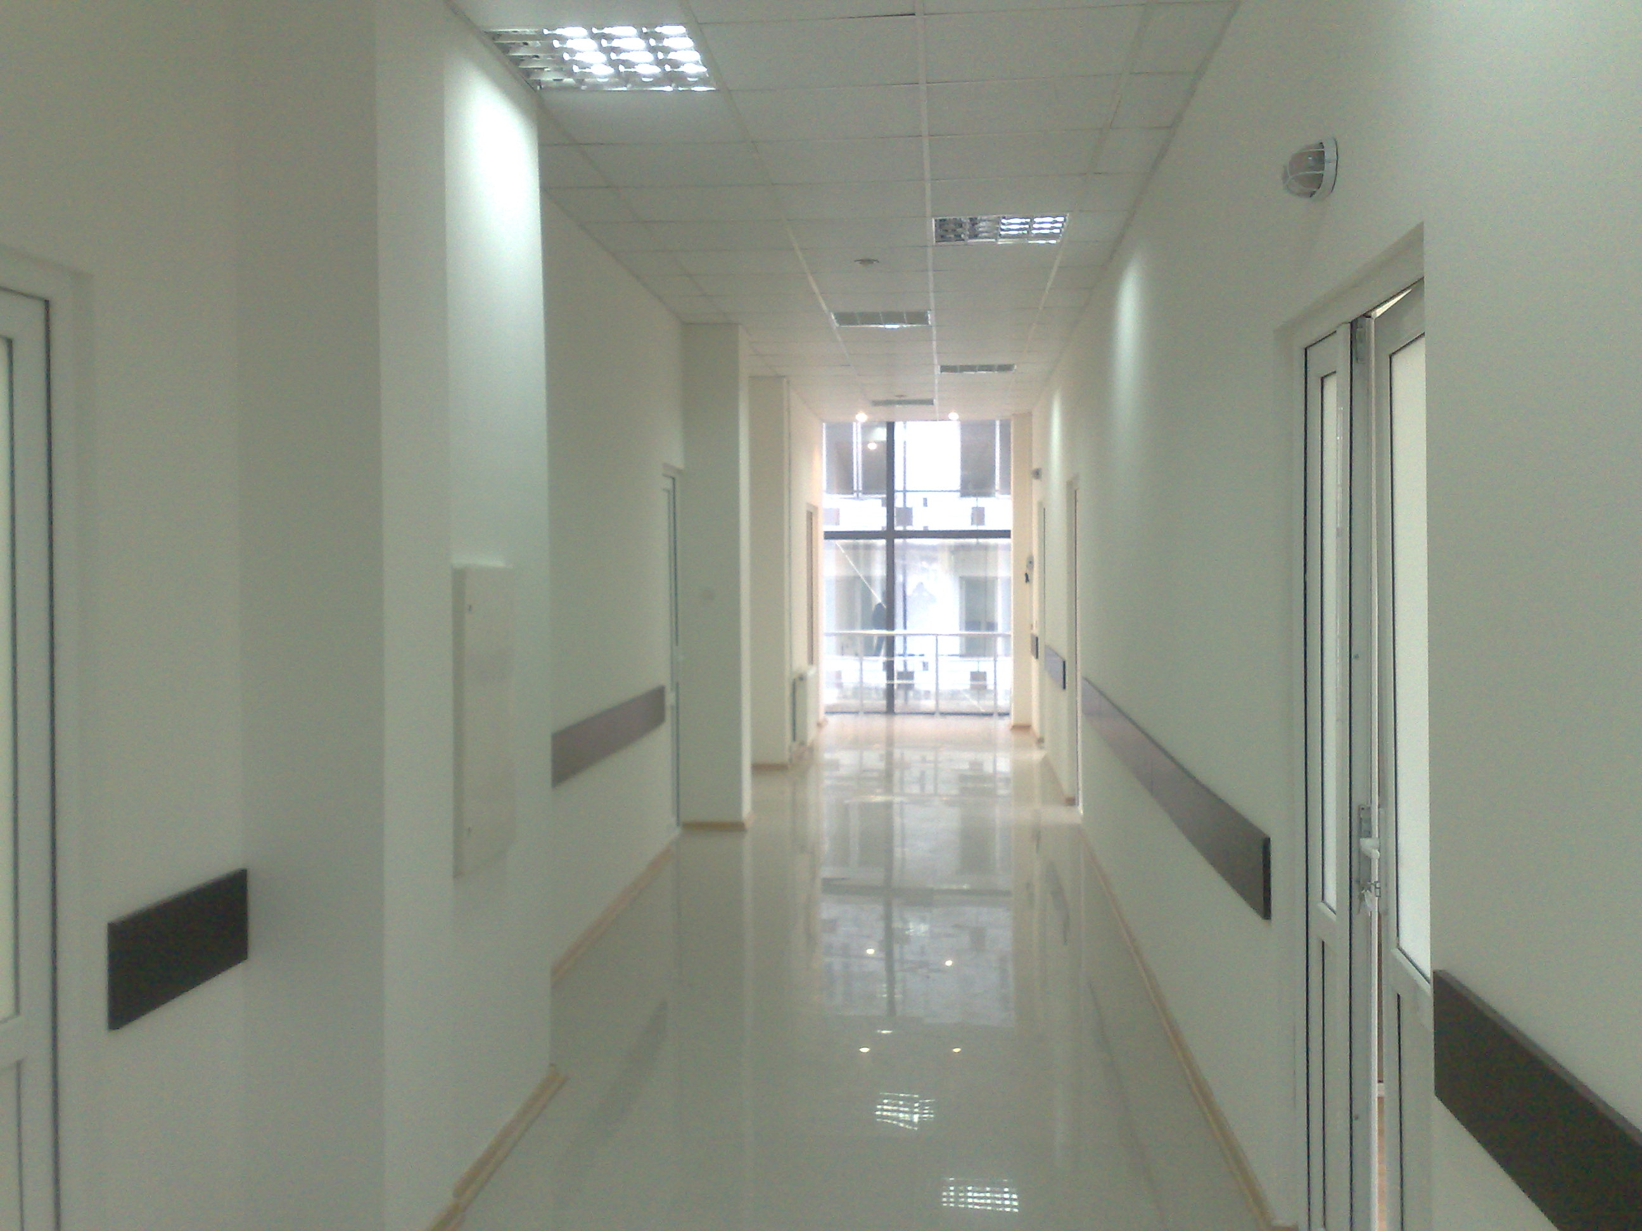
Ambrolauri Regional Hospital

Slide 11
Ambrolauri Regional Hospital
Location : Ambrolauri
Number of Beds: 25
Type: Construction
Due date: 25 January 2011
Budget: 1,7mln GEL
Financing resource: World Bank

Slide 12
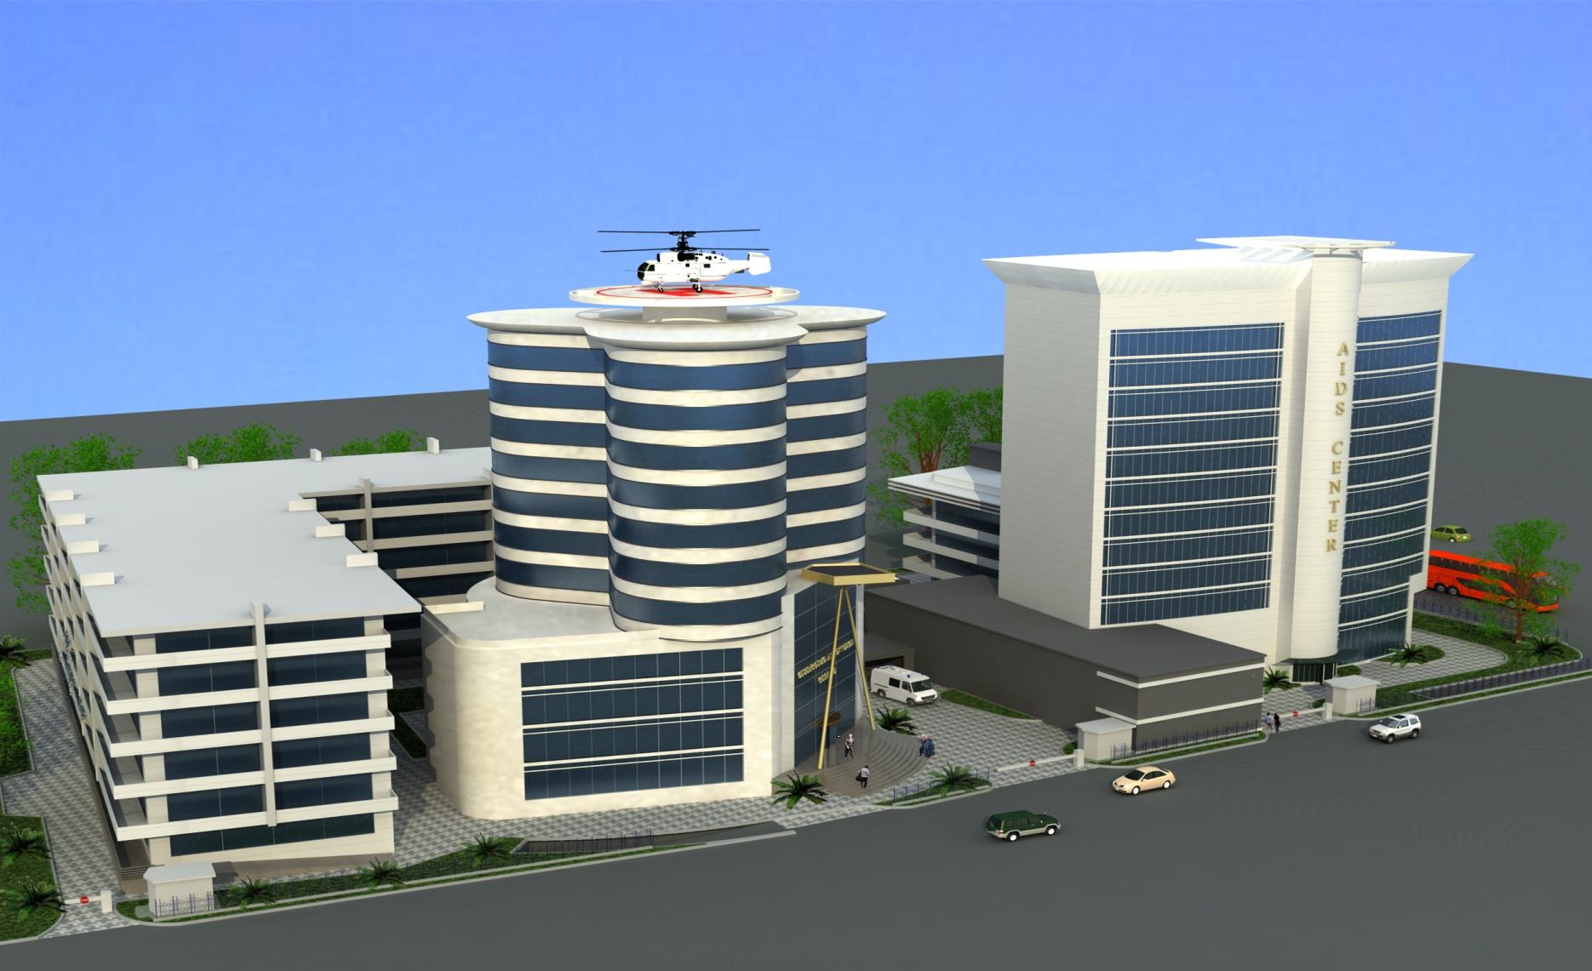
Infectious pathology ,aidsand clinical immunology research Centre

Slide 13
Infectious pathology ,aid and clinical immunology research centre
Location : Tbilisi
Number of Beds: 150 (Infectious desease Centre) & 80 (Aids Centre)
Type: Construction
Due date:2012
Budget: 24mln GEL
Financing Resource: Global Fund/ State Budget

Slide 14
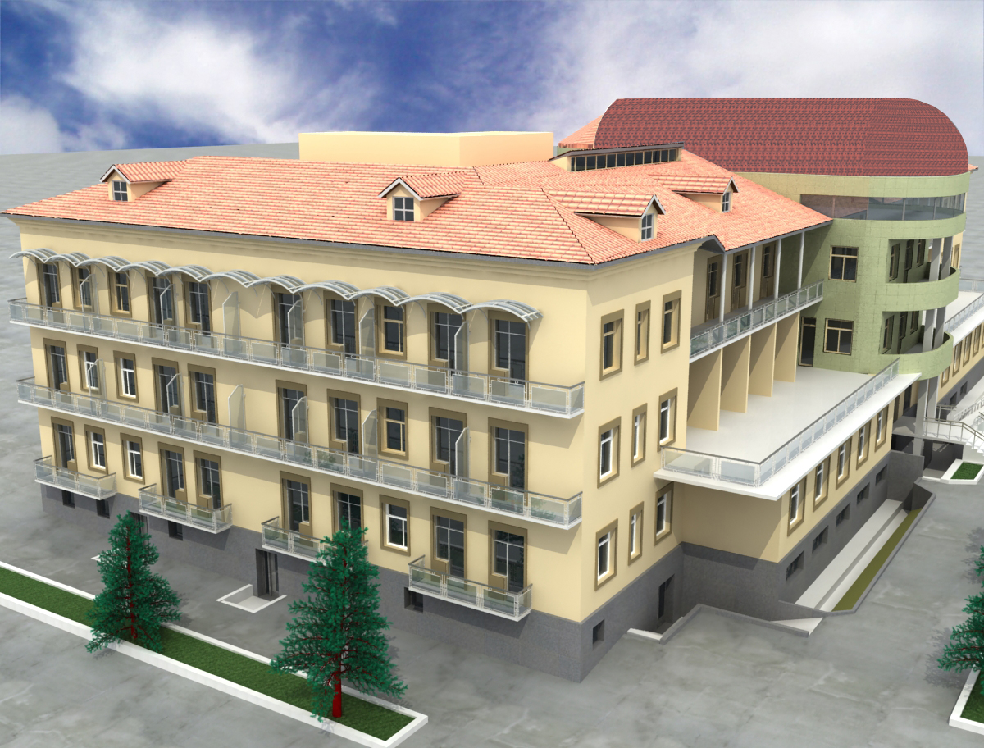
Tuberculosis Disease and Control Centre

Slide 15
Tuberculosis Disease and Control Centre
Location: Tbilisi
Number of Beds: 80
Type: Reconstruction
Due date: February 2011
Budget: 3 mln GEL
Financing Resource: Global Fund

Slide 16
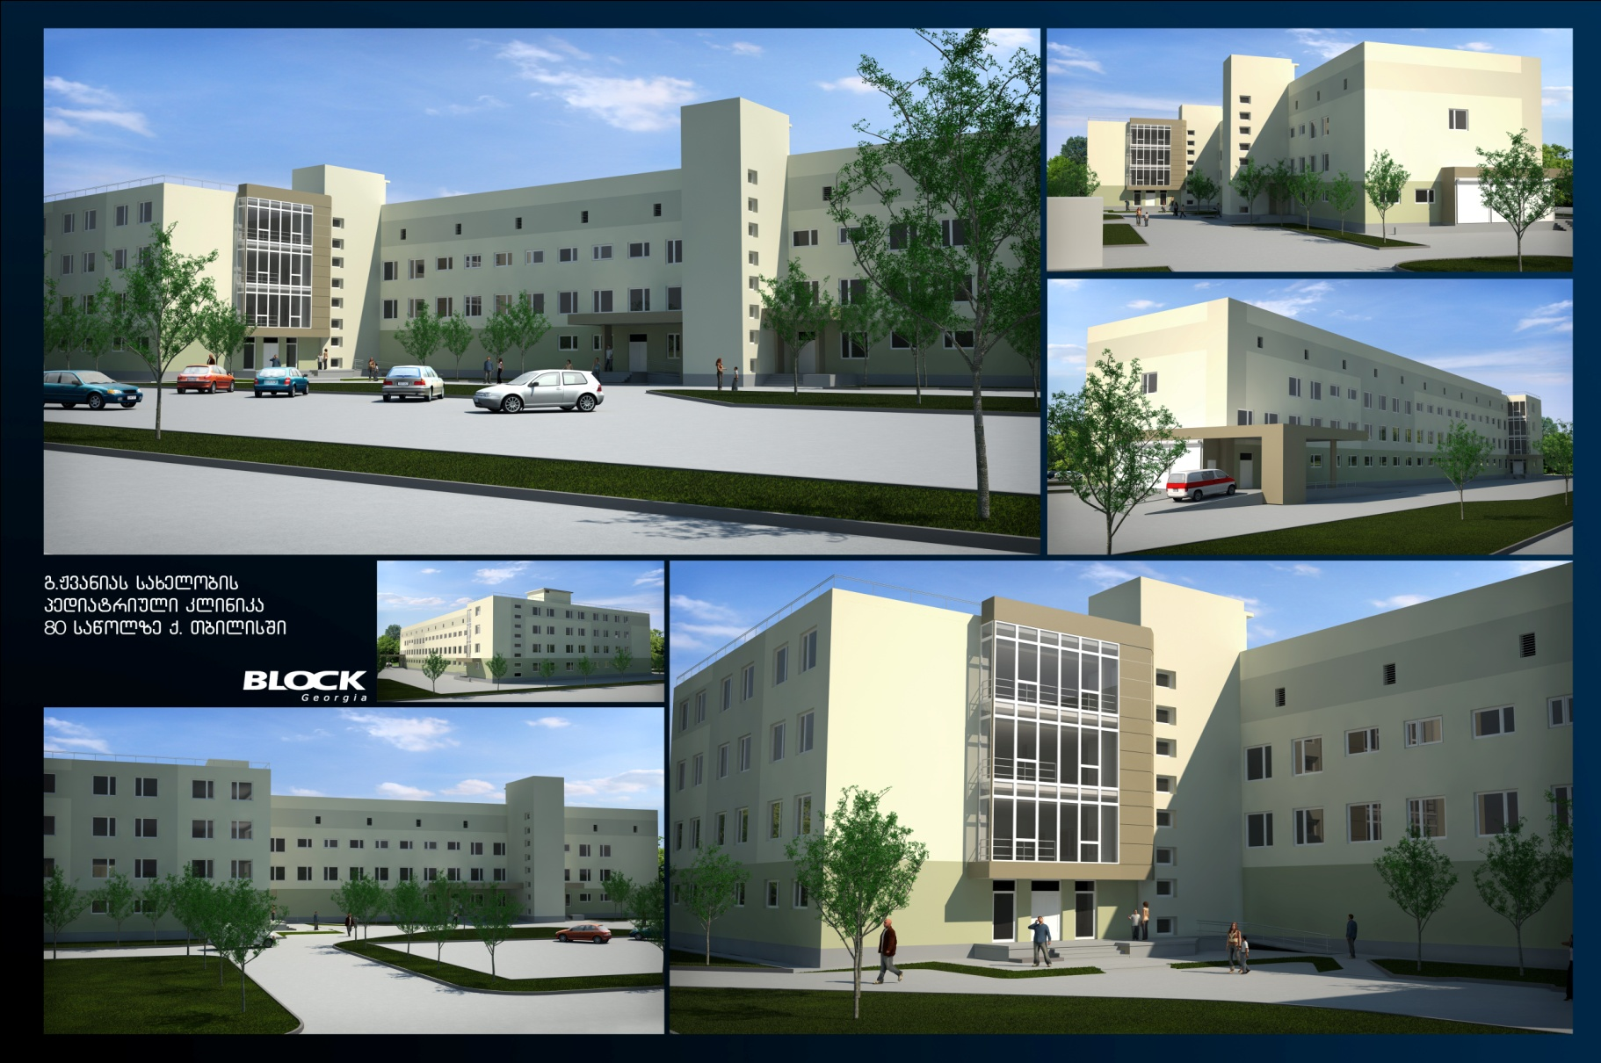
G.Zhvania Pediatric Clinic

Slide 17
G.Zhvania Pediatric Clinic and #2 Maternity Centre (50 bed)
Location :Tbilisi
Number of Beds :80 (Pediatric Clinic)& 50 (Maternity Centre)
Type: Reconstruction
Due date: April 2011
Budget :20 mln GEL
Financing Resource: State Budget

Slide 18
G.Zhvania Pediatric Clinic

Slide 19
G.Zhvania Pediatry Clinic

Slide 20
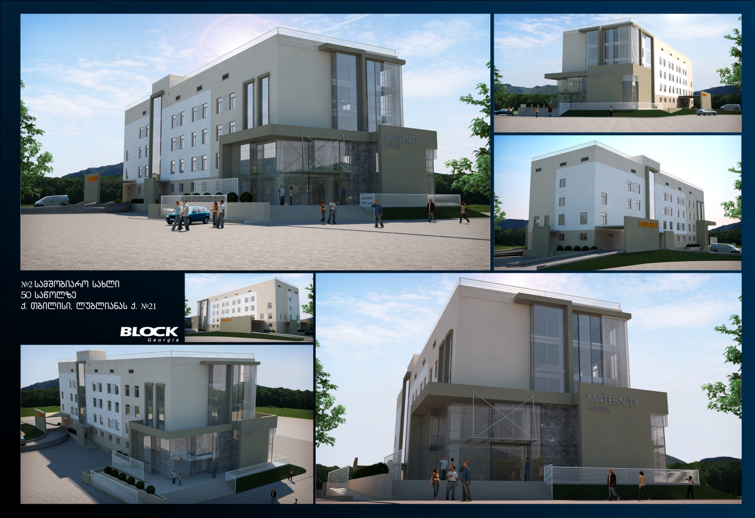
#2 Maternity Home (50 bed)

Slide 21
Tbilisi Central Hospital
Location: Tbilisi
Number of Beds: 380
Type: Reconstruction
Due date: April 2011
Budget: 14mln GEL
Financing Resource: State Budget

Slide 22
Tbilisi Central Hospital

Slide 23
Tbilisi Central Hospital

Slide 24
Tbilisi Central Hospital

Slide 25
Tbilisi Central Hospital

Slide 26
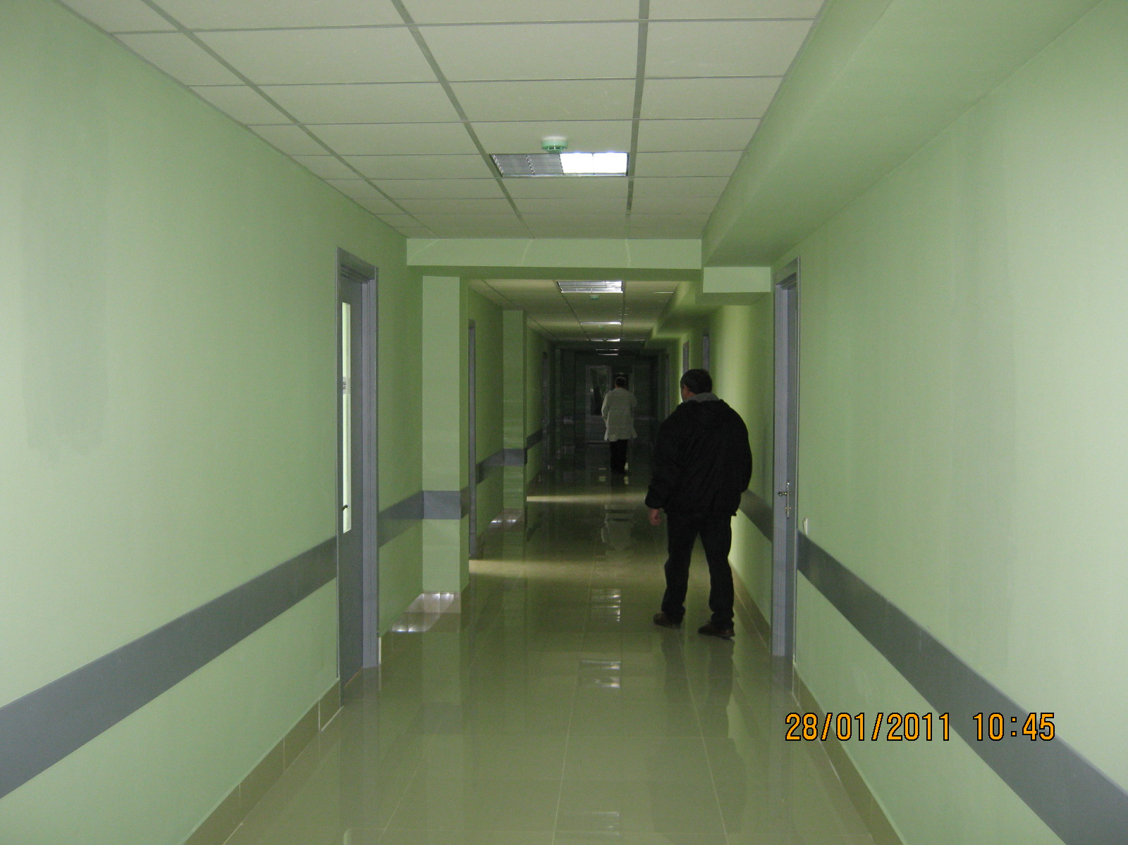
Tbilisi Central Hospital

Slide 27
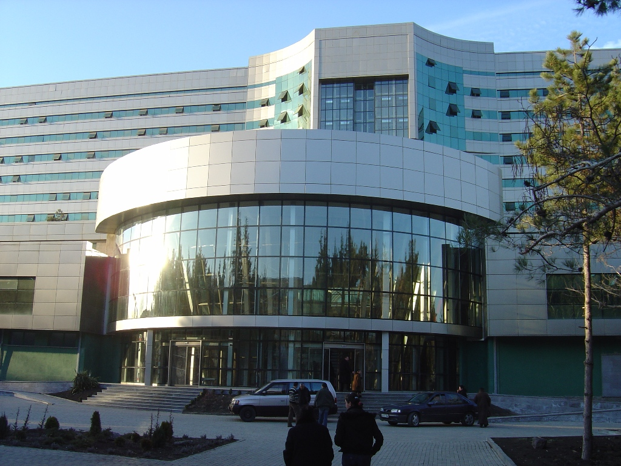
State Medical University Hospital

Slide 28
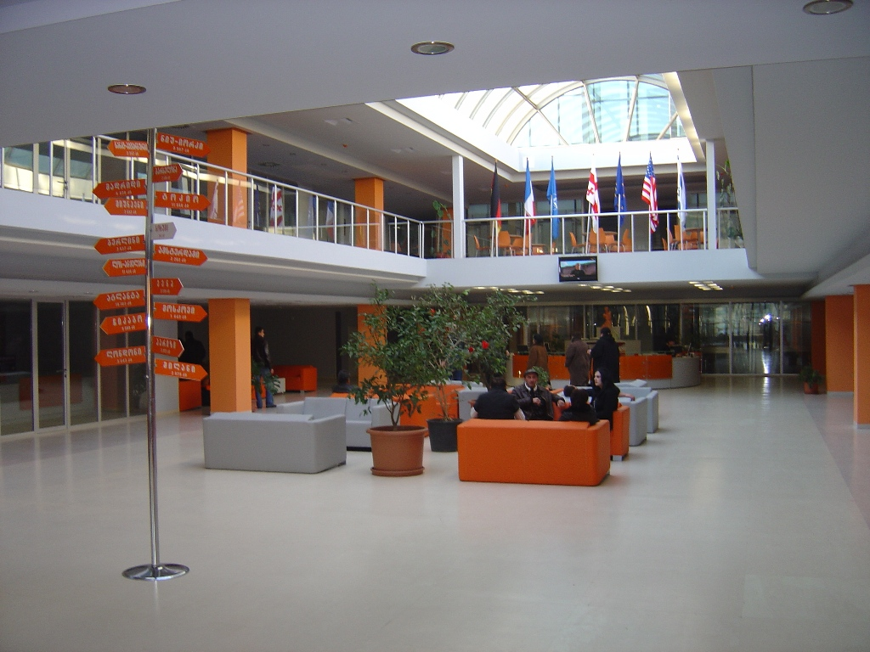
State Medical University Hospital

Slide 29
State Medical University Hospital (ICU)
Location: Tbilisi
Budget:16mln
Type: Reconstruction
Financing Resource: State Budget

Slide 30
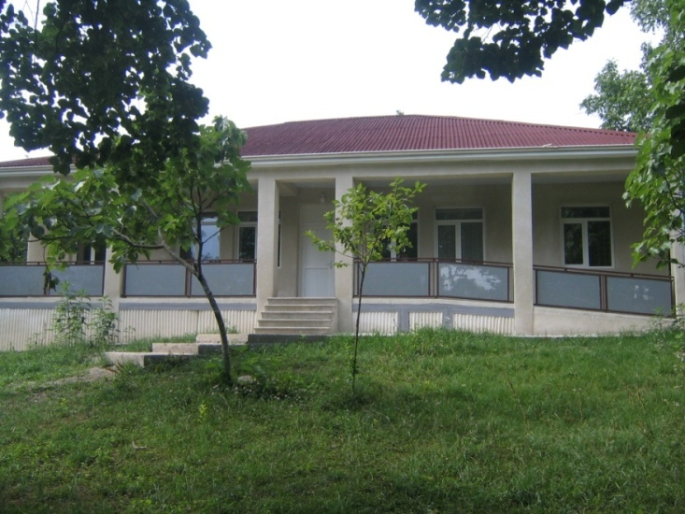
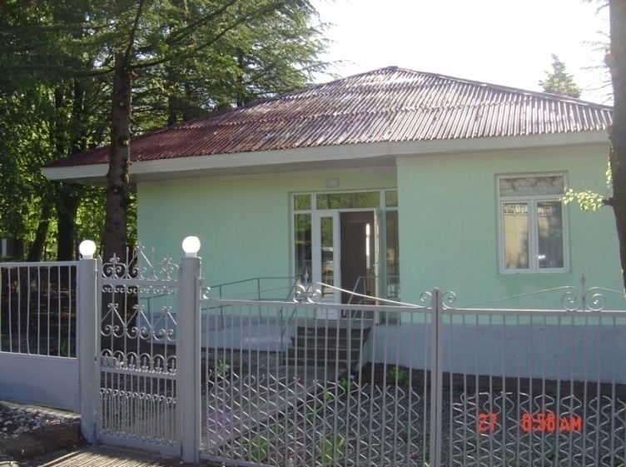
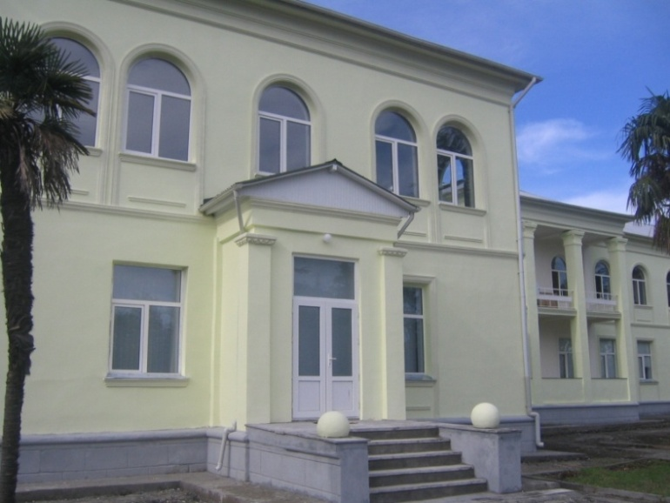
Service Provision: Primary Health Care
Infrastructure (target - 635)
178 PHC facilities were fully rehabilitated
777 family doctors were granted by state to rehabilitate offices
More than1 550 PHC practices
are individually contracted
as independent service
providers
Notes:
Accidental entrepreneurs (physical entity) with the trend to diversify the income, including insurance companies.
Privatization process
Donors’ support over years, training facilities establishes in regions

Slide 31
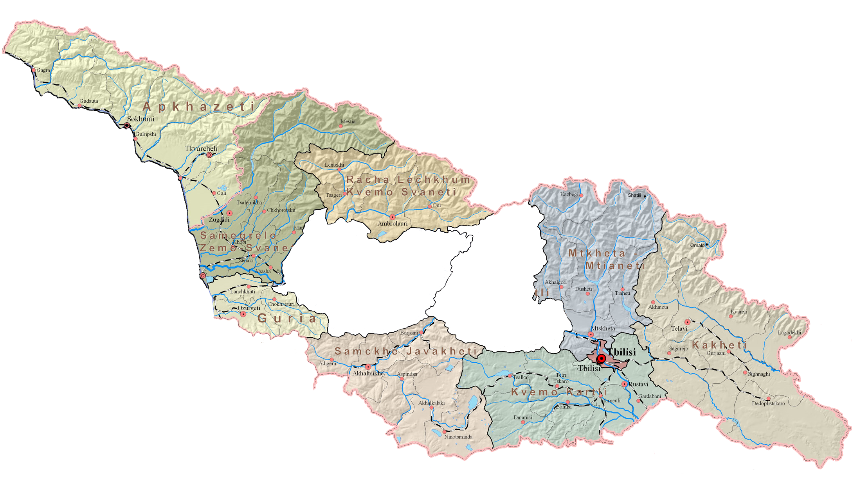
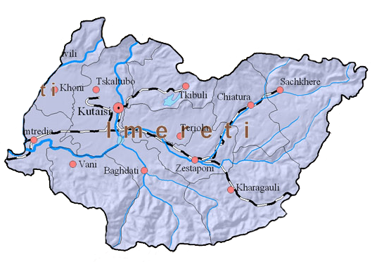
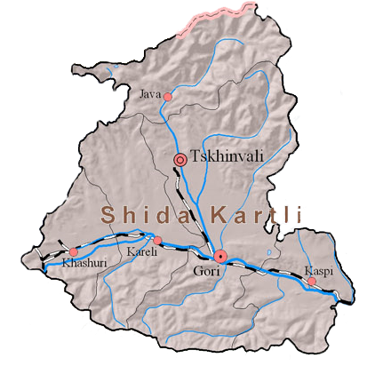
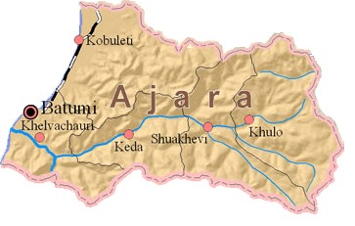
Investment in PHC
47 PHC facilities
22 PHC facilities
Ochamchire
34 PHC facilities
Poti
Number of PHC facilities:

Slide 32
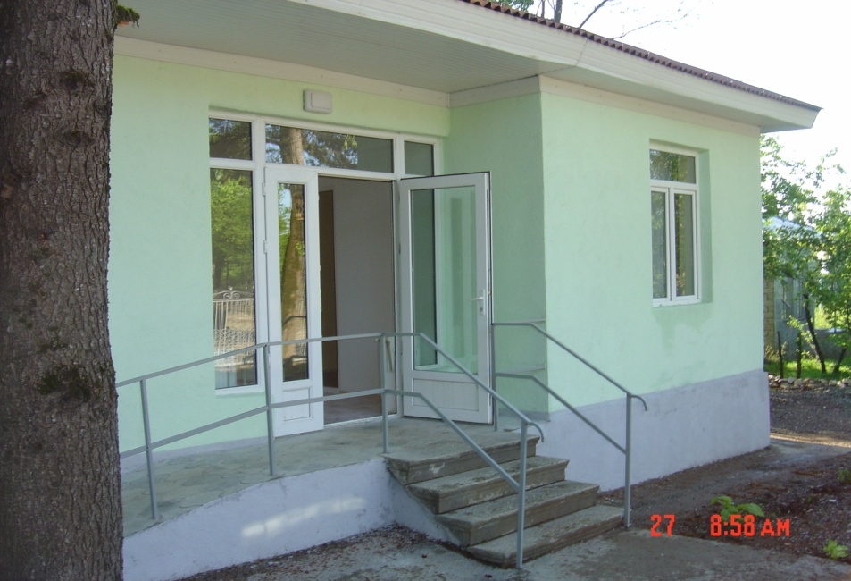
Village Tsutskhvati
Village Gorda
Village Zegani

Slide 33
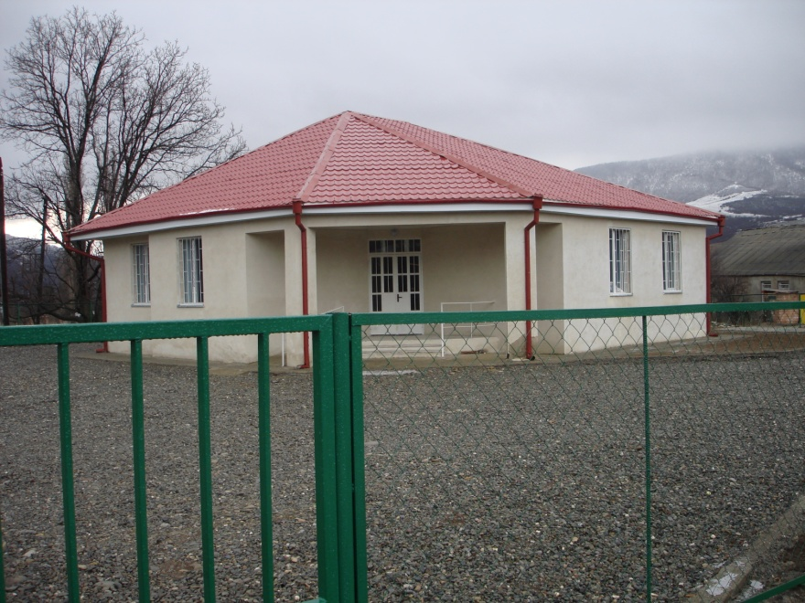
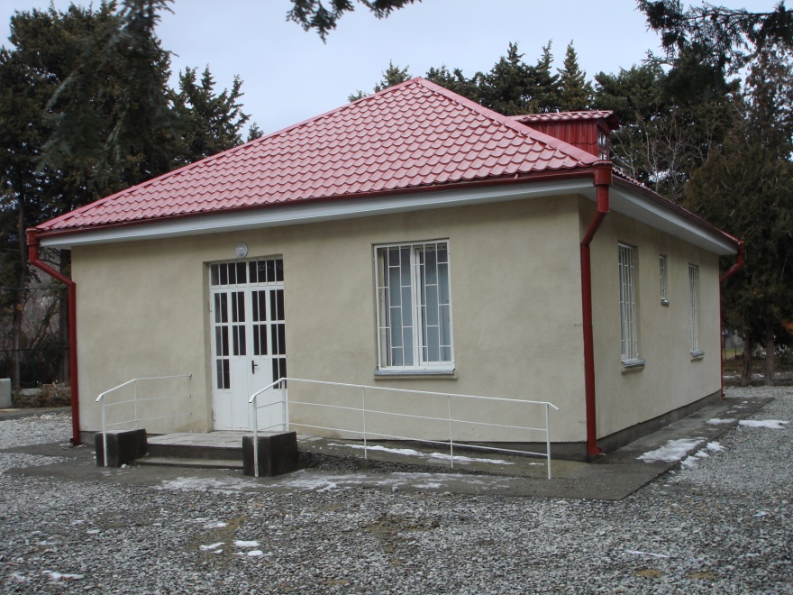
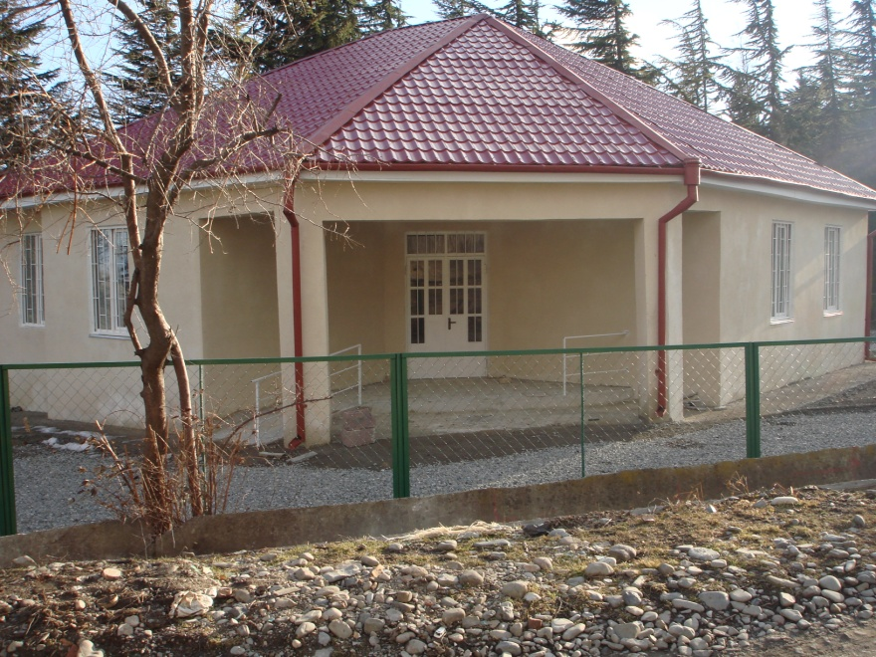
Village Igoeti
Village Okami
Village Kvemo Chala

Slide 34
Investment in Public Health/Lab Network
Construction of 5 LLC within Primary Health Care Development Project (EU)
Akhaltsike
Ambrolauri
Poti
Zugdidi
Ozurgeti

Slide 35
Investment in Human Resources
Training of FM Doctors and Nurses
Trainings in Guidelines and Protocols
Trainings in Managment
Trainings in Private Medical Practice Managment
Modular Training

Slide 36
FM trainings: who and how much
Notes:
In real terms – 2 124 teams should be re-trained, out of which 370 teams is a target for WB project
About clinical guidelines and protocols – 625 doctors will be trained (29% of the whole need of the country), around 40 % left uncovered

Slide 37
Training Centers in:
Batumi
Kobuleti
Kutaisi
Gori
Tbilisi
Rustavi

Slide 38
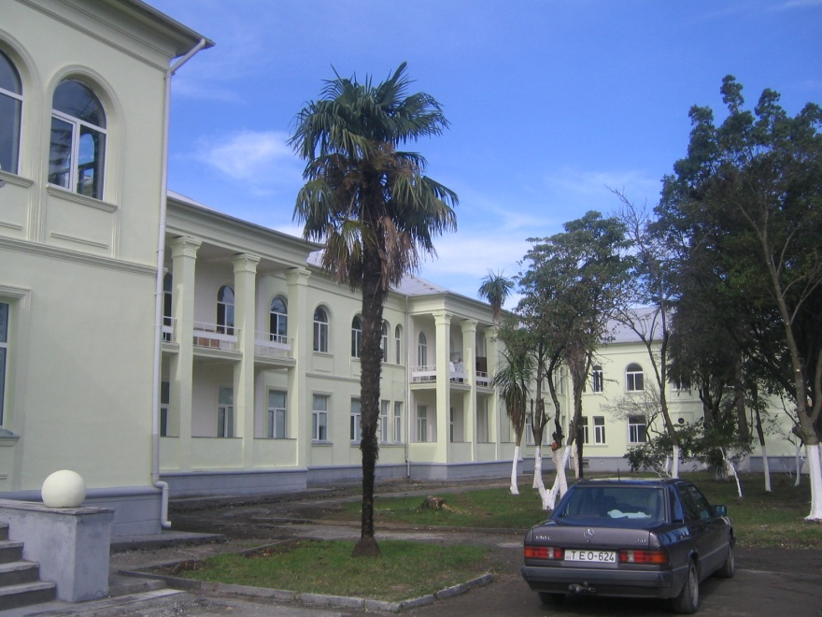
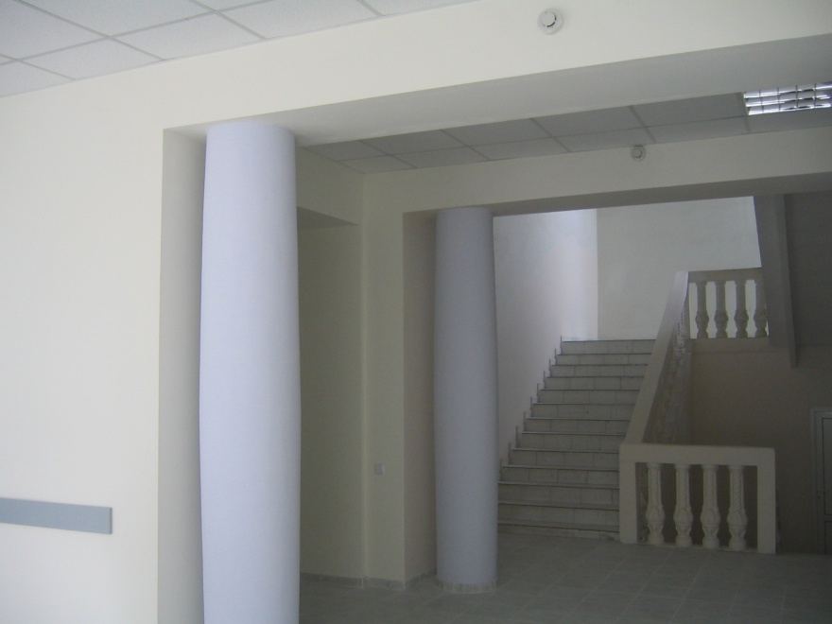
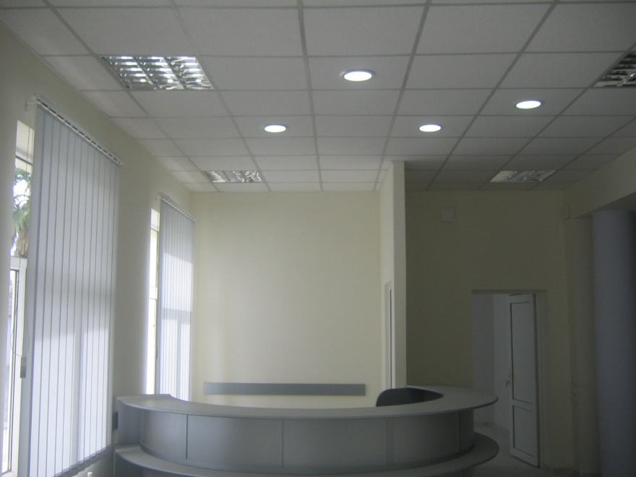
Kobuleti FM Training Centre

Slide 39
Thank You !

