Slide 1
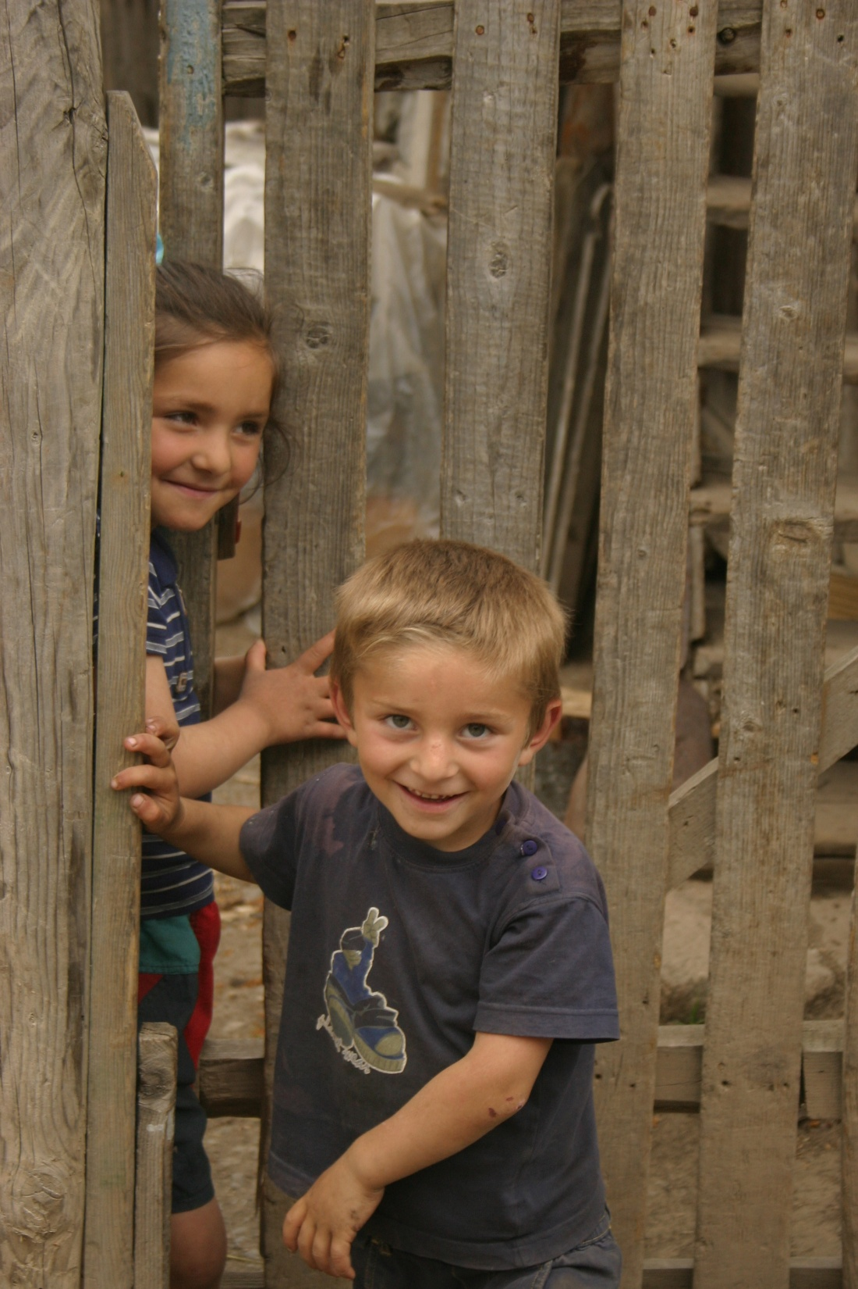
Rostropovich-Vishnevskaya Foundation
For the health and future of children

Slide 2
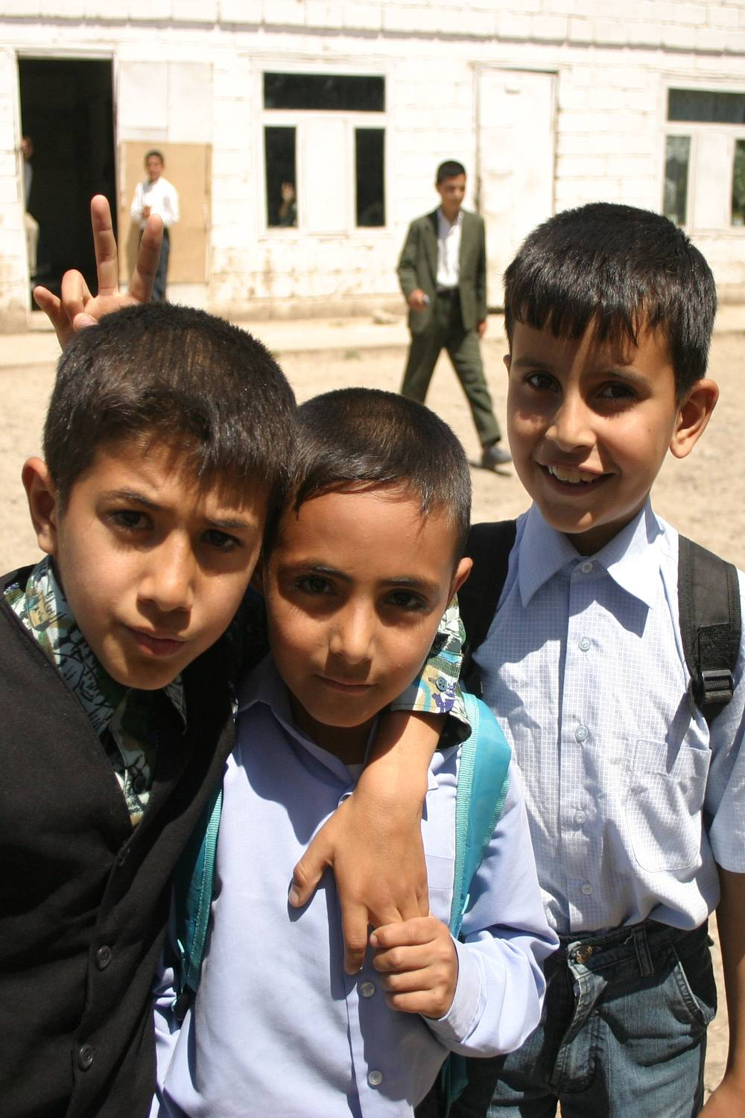
Mission
The Rostropovich-Vishnevskaya Foundation (RVF) is a non-political, non-partisan organization whose mission is to improve the health and wellbeing of children in need through selected, sustainable, and transformational public health programs.

Slide 3
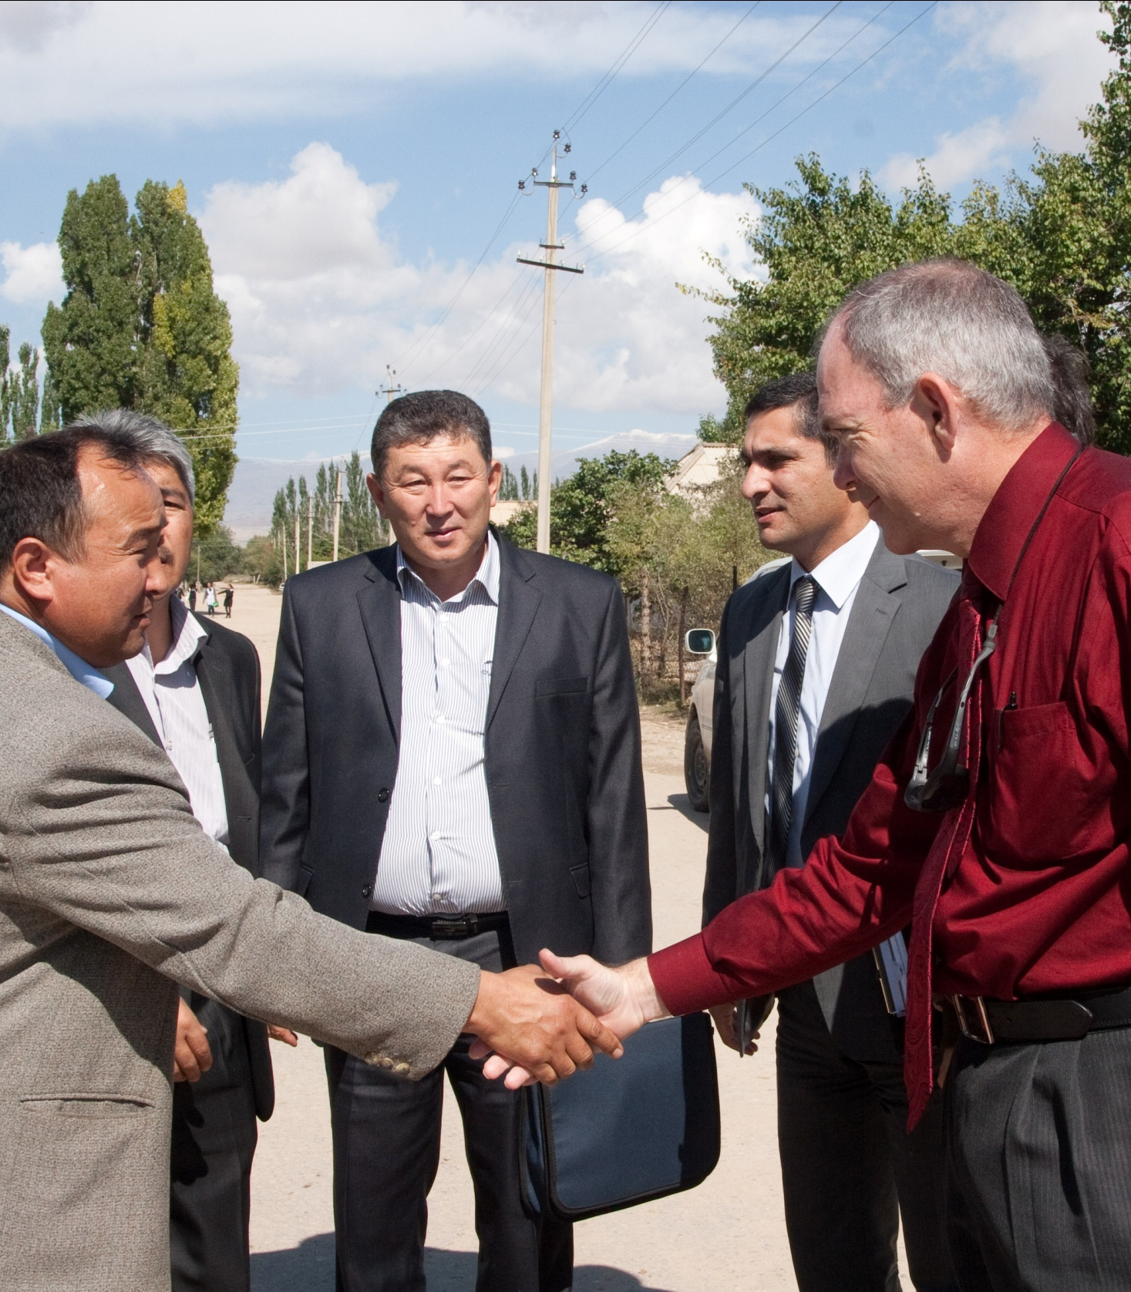
Modus Operandi
Provide highly skilled management teams to bring together all stakeholders – political, public health, scientific, financial – to create an efficient, effective, and successful program with well-defined goals and outcomes.

Slide 4
Where We Work
Georgia
Armenia
Azerbaijan
Russia
Kyrgyzstan
Tajikistan
West Bank & Gaza

Slide 5
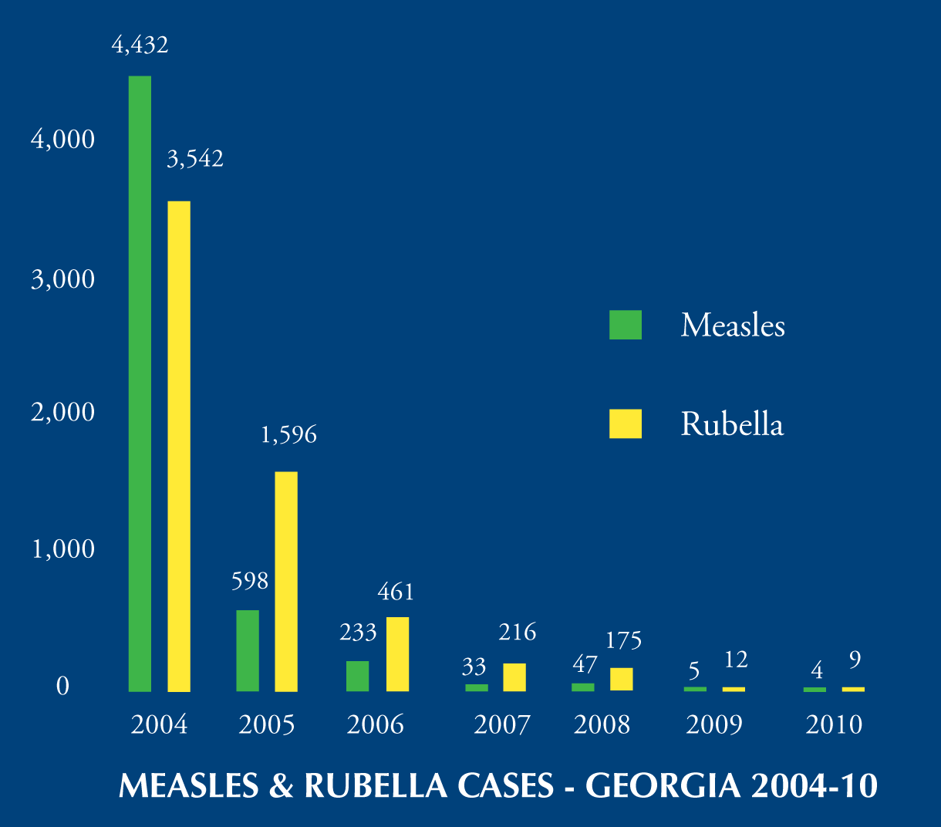
Programs
Vaccination
Hep B
MMR
Hib
Pneumococcal
Deworming
Screening & Prevention
HIV
Hep B
Epidemiological Research
Hib
Pneumococcal
Helminith Infection

Slide 6
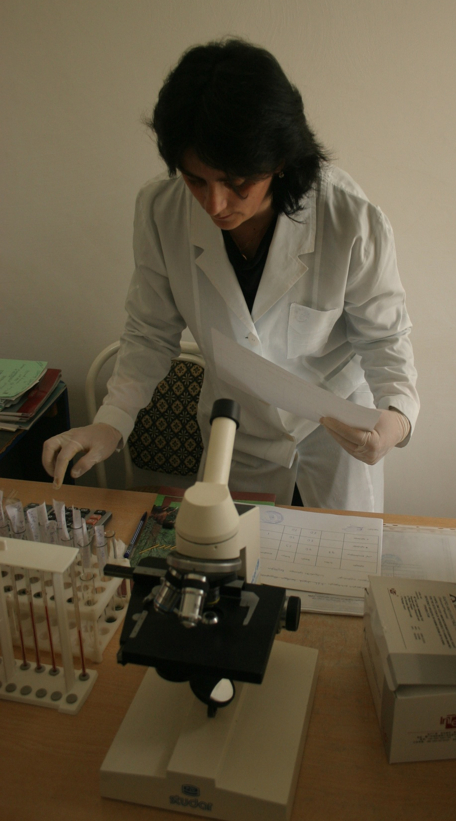
Georgia Current Programs
HIV/Hep B Screening and Prevention of Transmission from Mother to Child
Hep B Vaccination of Health Care Workers, Medical Students & Adolescents

Slide 7
GEORGIA Completed Programs
Eliminating Measles & Preventing Congenital Rubella Syndrome
Introduction of MMR vaccine
Mass MR campaign (SIA)
Protecting newborns from hypothyroidism
Nationwide TSH screening
Timely notification of TSH results for intervention

Slide 8
GEORGIA Completed Programs
PMTCT of HIV
All pregnant women screened 2007-10
ART for all HIV+ women
All of these programs initiated by the Foundation are now being sustained entirely by the Georgian government

